Slide 1
Meta Analytics for the Advertising Panel for Mexico
Anson Hsu, Aidan Nguyen, Ryan Wong, James Baguley

Slide 2
Table of Contents
1. Introduction of Company
2. Feature Description
3. The Most Successful Ad
4. Trend in Terms of Audience Segmentation
5. Traffic by Region of Traffic by Region

Slide 3
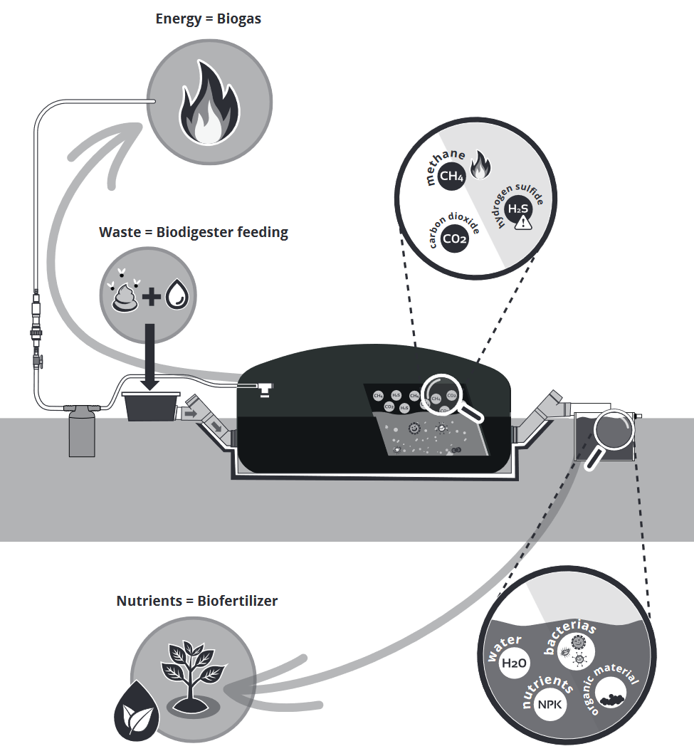
Introduction to Sistema Biobolsa
Socially-conscious Privately-held company focusing on renewable energy through biodigester technology.
Main customer base are small-holder farmers, in Latin America, Africa and India.
In the process of transitioning from traditional advertising methods to digital marketing, primarily Facebook ads.

Slide 4
Feature Description
age: Age groups of the audience reached by the advertisements.
Gender: Gender of the audience reached by the advertisements.
ad_delivery: The status of ad delivery, whether the ad is delivering or not delivering.
post_reactions: The number of reactions received on posts related to the ad.
post_comments: The number of comments made on posts related to the ad.
post_shares: The number of shares made on posts related to the ad.
link_clicks: The number of clicks on links within the ad.
follows_or_likes: The number of follows or likes received on the ad.
cpc_cost_per_link_click: The cost per click for link clicks in the ad.
reach: The total number of unique people who saw the ad.
impressions: The total number of times the ad was displayed.
clicks_all: The total number of clicks on all elements of the ad.
cpc_all: The cost per click for all clicks on the ad.
amount_spent: The total amount spent on the campaign.
year: The year in which the campaign was conducted, represented as a numerical value

Slide 5
The Most Successful Ad
Analyzing reach reveals ad effectiveness and engagement levels.
Identifying accurate predictive models unveils key campaign success attributes.
Forecasting for Sistema aids data-driven decisions in future campaigns.
Optimization through strategic attribute promotion shapes targeted strategies.

Slide 6
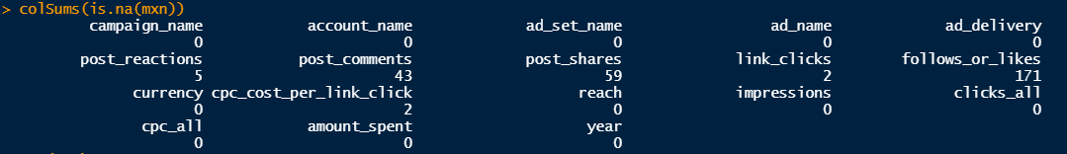
The Most Successful Ad
EDA:
Leveraging datasets "2022_Mx_campaigns-Engagement", "2022_Mx_Campaigns-performance", "2023_Mx_campaigns-Engagement", and "2023_Mx_Campaigns-performance" to create "mxn" dataset.
Noticing missing values in variables

Slide 7
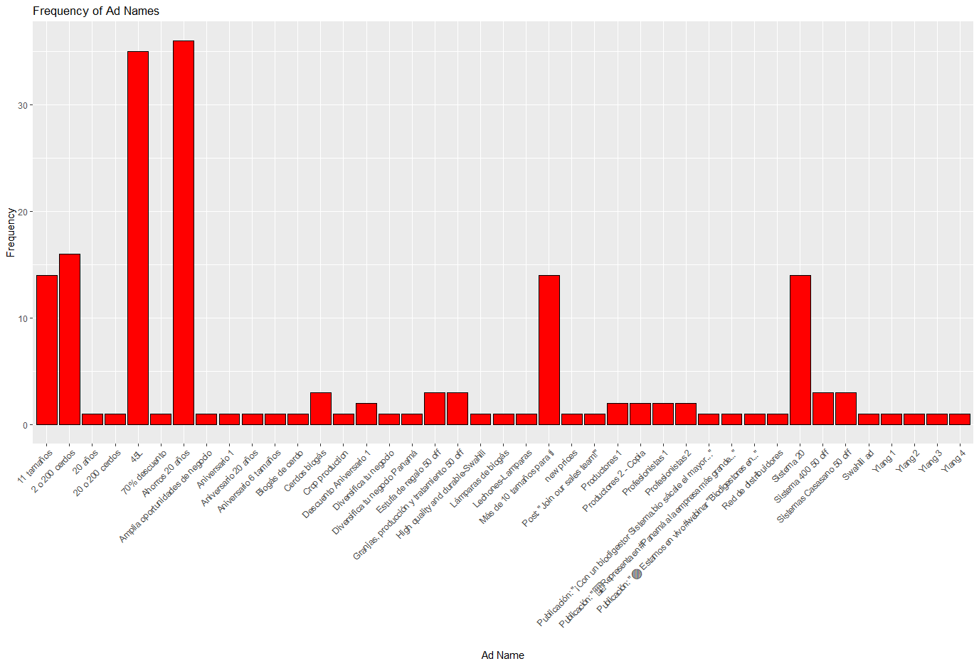
The Most Successful Ad
EDA:
Most advertisements (ADs) have a frequency of less than 5, with only 6 ADs exceeding a frequency of 10.
Each AD's campaigns are unique

Slide 8
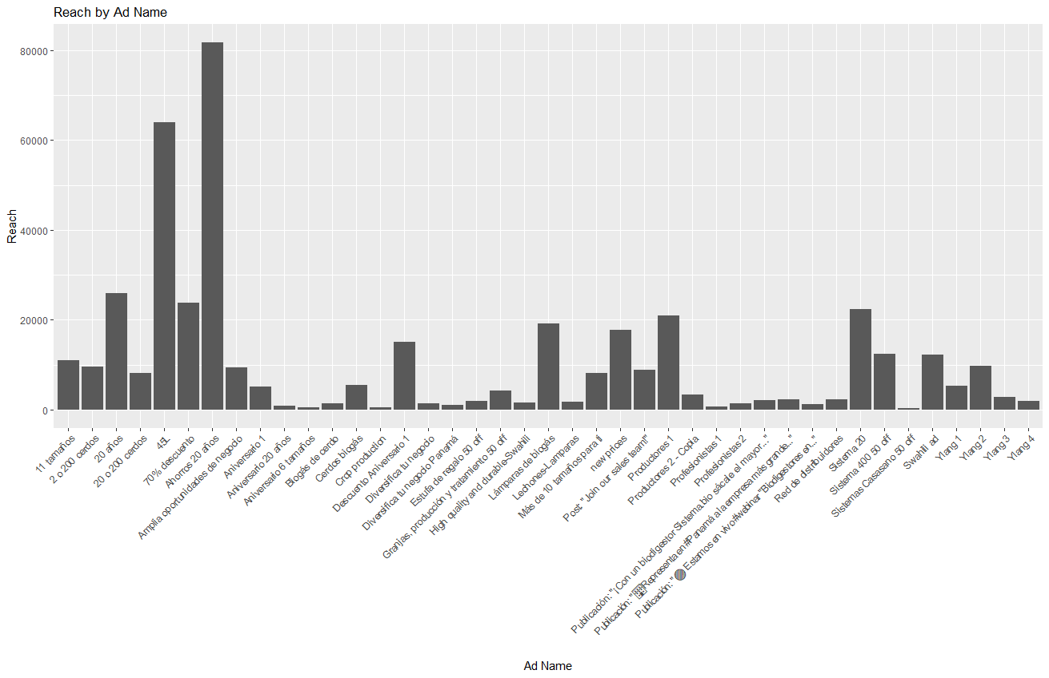
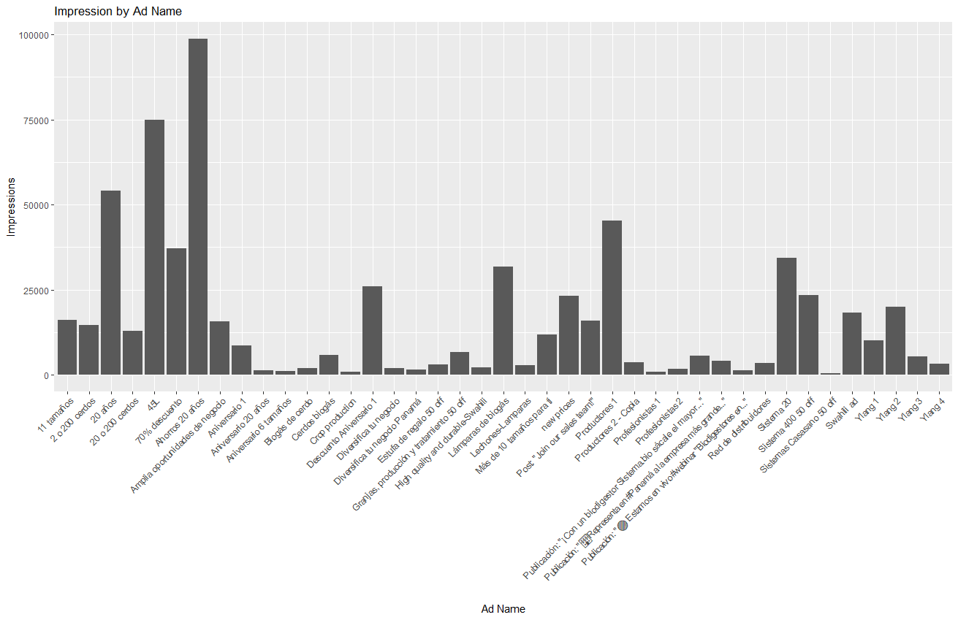
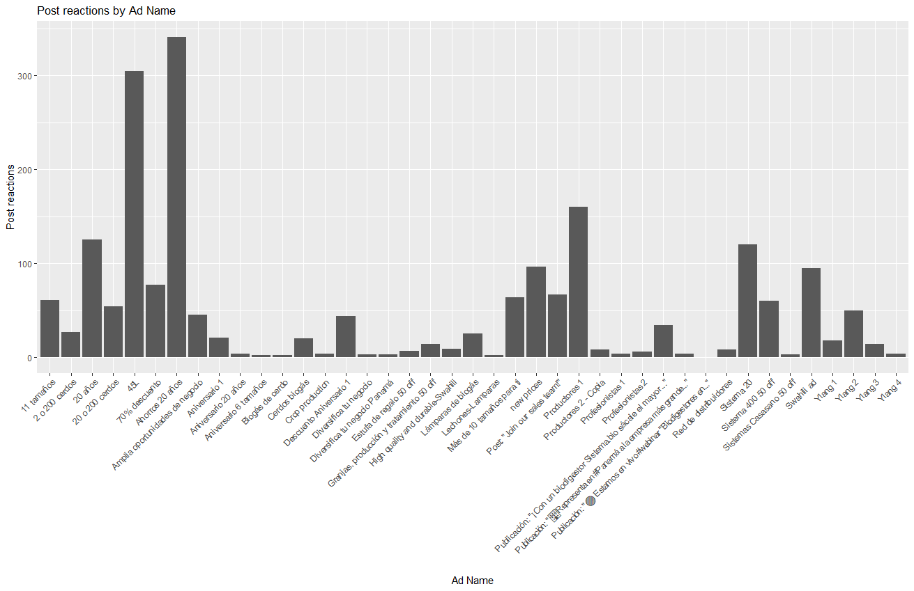
The Most Successful Ad
EDA:
Similar distributions for most of features
The Most successful AD:"Ahorros 20 anos" showing higher values likely maybe due to his higher frequency

Slide 9
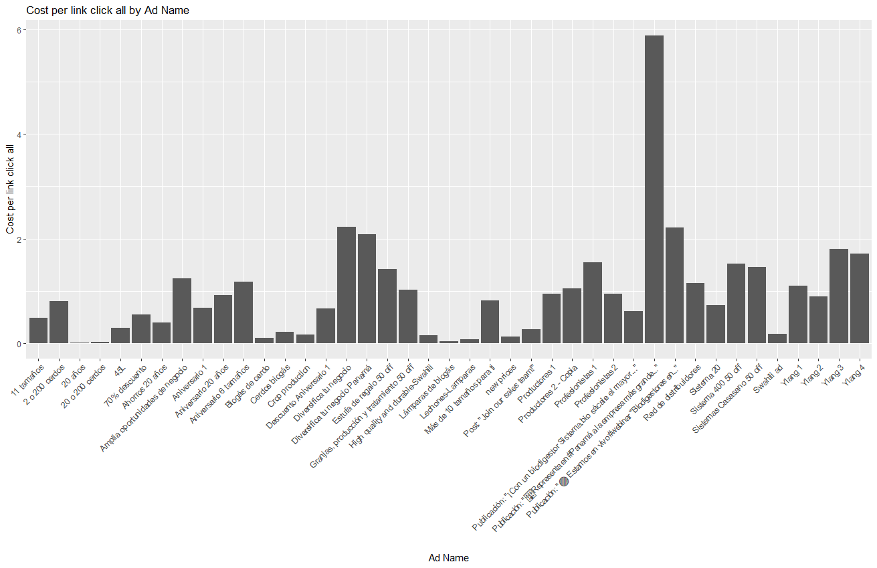
The Most Successful Ad
EDA:
"cost_per_link" is its indication that higher costs per link
The unique aspect is it is same distribution with others features
Associated with ADs featuring lower frequencies

Slide 10
The Most Successful Ad
Preprocessing: missing value
For the "follows_or_likes" feature, NA values will be replaced with 0
The other numerical features will fill with the average.
Preprocessing: aggregation with group by AD
Aggregating metrics like "post_reactions", "post_comments", "post_shares", "follows_or_likes", "cpc_cost_per_link_click", "impressions", "clicks_all", "cpc_all", "amount_spent", and "reach" by computing their averages.
Aggregating "link_clicks" as a total and categorizing "ad_delivery" as "inactive" if no ad delivery within the group.
Conducting frequency count for each AD and creating "year_2022" and "year_2023" columns to indicate campaign counts for 2022 and 2023.

Slide 11
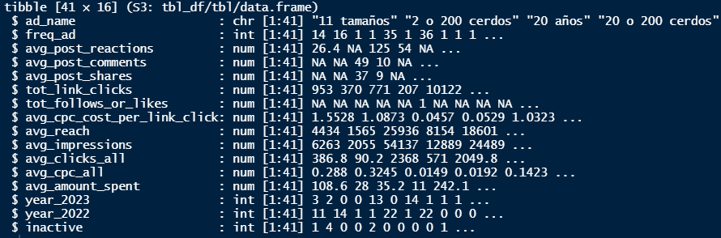
The Most Successful Ad
Preprocessing: The data before the modeling

Slide 12
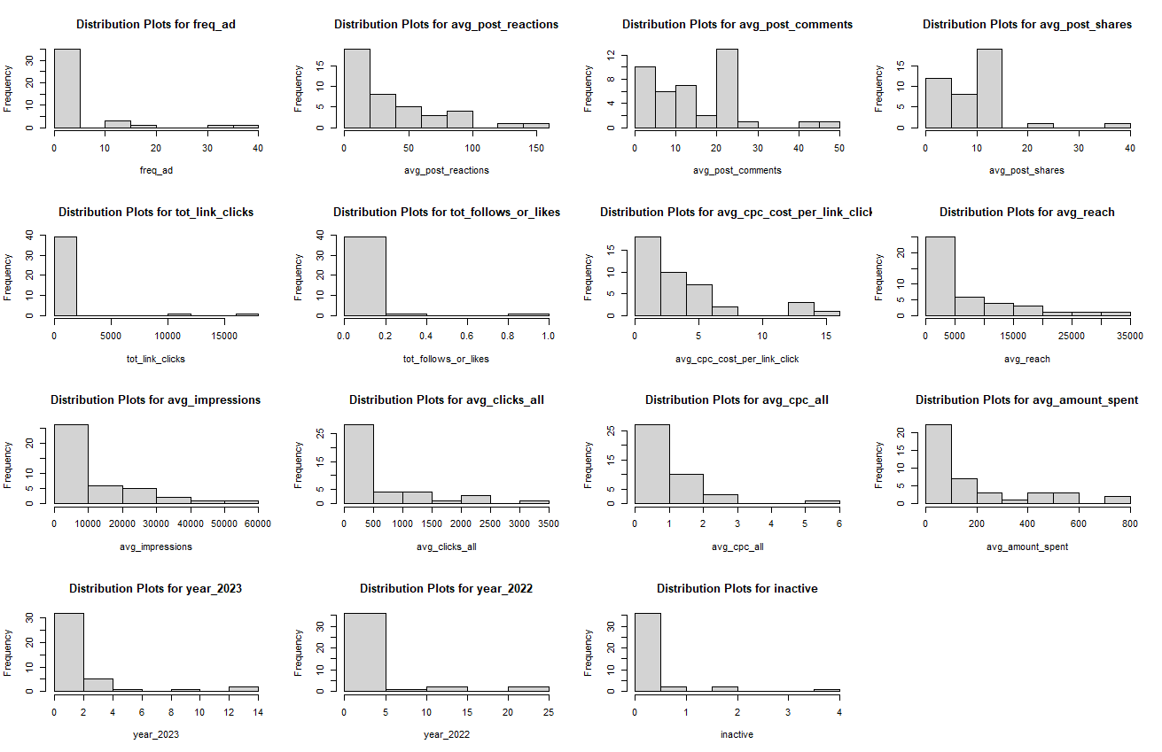
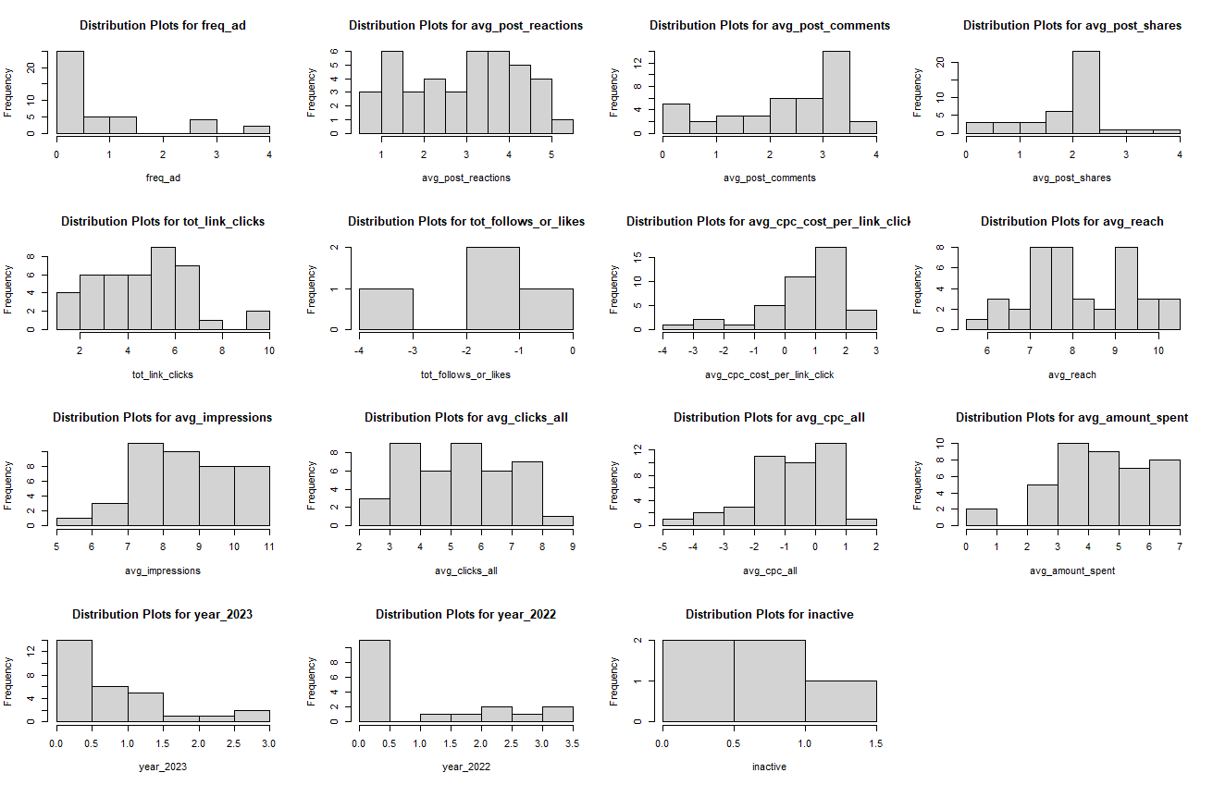
The Most Successful Ad
Preprocessing: Feature Transforming by LOG()

Slide 13
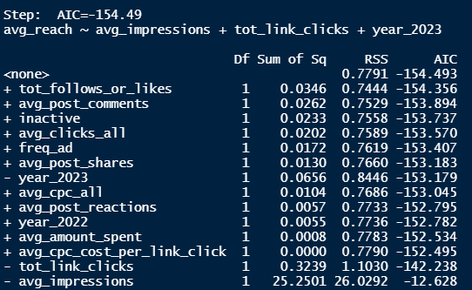
The Most Successful Ad
Model: Stepwise Feature Selection
Not Selected
year_2023,
(correlated with year_2023)
Tot_link_clicks
(correlated with avg_clicks_all)
avg_impressions
(too much similar as reach)

Slide 14
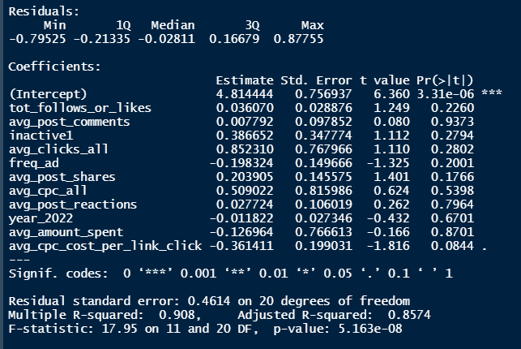
The Most Successful Ad
Model: Modeling
R-squared equals to 0.908
The significant feature is avg_cpc_cost_per_link_clickat 10% level of significance
By comparing, the top 3 of
1)avg_cpc_cost_per_link_click
2)avg_post_shares
3)lowest p-value are freq_ad

Slide 15
The Most Successful Ad
Model: Modeling
avg_amount_spent: For every one percent increase in the number of followers or likes, the estimated percentage increase in reach is exp(0.036070)=1.04%.
Avg_Post_Comments: For every one percent increase in the number of comments, the estimated percentage increase in reach is exp(0.007792)=1.01% .
Inactive1: The presence of inactive campaigns is associated with a 38.6652% increase in reach, relative to the log scale.
Avg_Clicks_All: For every one percent increase in the number of clicks, the estimated percentage increase in reach is exp(0.852310) =2.35%.
Freq_Ad: For every one percent increase in the frequency of ads, the estimated percentage decrease in reach is exp(0.198324)=1.22%
Avg_Post_Shares: For every one percent increase in the number of shares, the estimated percentage increase in reach is exp(0.203905)=1.23%.

Slide 16
The Most Successful Ad
Model: Modeling
Avg_CPC_All: For every one percent increase in the average cost per click, the estimated percentage increase in reach is exp(0.509022)=1.66%.
Avg_Post_Reactions: For every one percent increase in the number of post reactions, the estimated percentage increase in reach is exp(0.027724)= 1.03%.
Year_2022: For every one percent increase in the number of campaign in 2022, the estimated percentage decrease in reach is exp(0.011822)=1.01%
Avg_Amount_Spent: For every one percent increase in the average amount spent, the estimated percentage decrease in reach is exp(0.126964)=1.04%
Avg_CPC_Cost_Per_Link_Click: For every one percent increase in the average cost per link click, the estimated percentage decrease in reach is exp(0.361411)=1.44%.

Slide 17
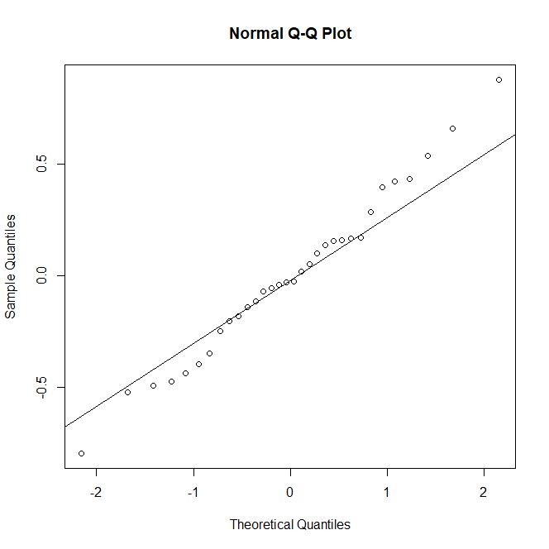
The Most Successful Ad
Model: Result
The mean absolute percentage error (MAPE) and mean absolute error (MAE) on training are 3.71% and 0.286 respectively,
The MAPE and MAE on testing are 4.28% and 0.350 respectively.
The QQ-plot indicates that our model’s residual is normal.

Slide 18
Conclusions/Recommendations
Cost efficiency of attracting clicks, the level of engagement through shares, and frequency of ad placements are critical factors influencing reach.
Utilizing these insights, Sistema can optimize campaigns, allocate resources efficiently, and boost audience engagement through strategic attribute promotion.
Performance metrics like MAPE and MAE showcase the model's accuracy in predicting reach, supported by the QQ-plot confirming its reliability.
Our data-driven approach empowers Sistema with actionable insights, enabling the creation of impactful advertising strategies that drive success and maximize ROI.

Slide 19

Demographic Analysis
Due to novelty of Sistema’s digital marketing, demographics regarding online engagement are largely unknown.
Purpose of this analysis is to discover who is viewing and clicking on these Facebook ads.

Slide 20
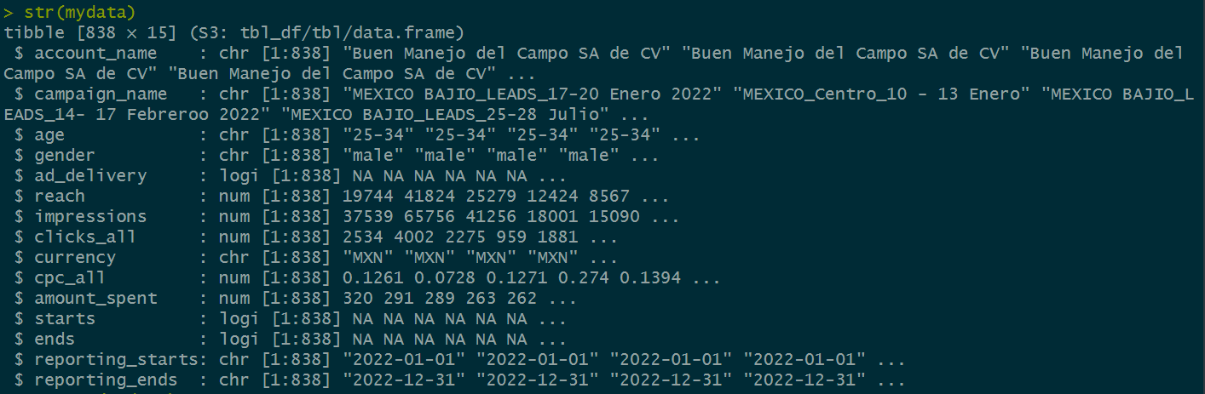
Data
Reach, impressions, clicks, cpc, etc. grouped by age, gender and campaign, from start of 2022 to end of 2023.

Slide 21
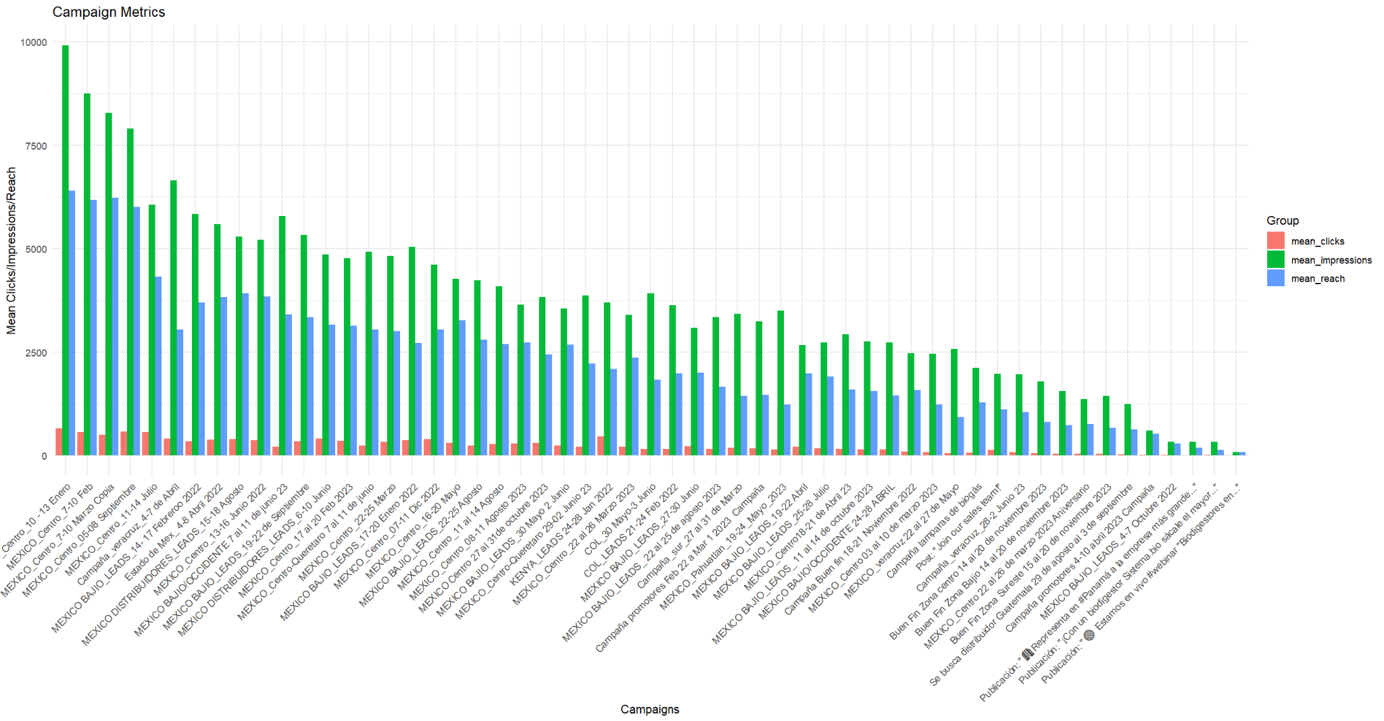
EDA

Slide 22
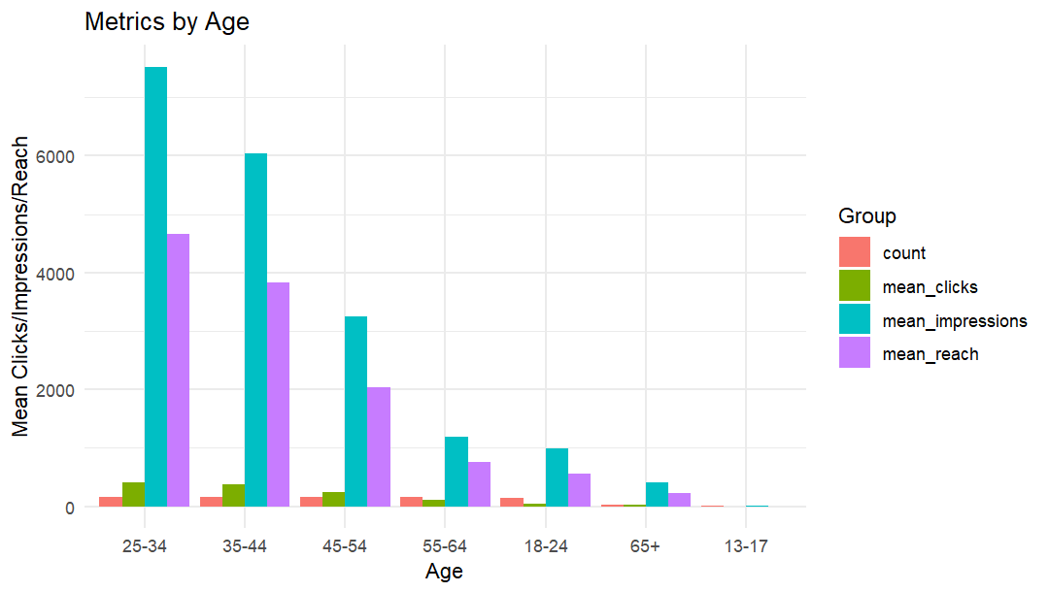

Slide 23
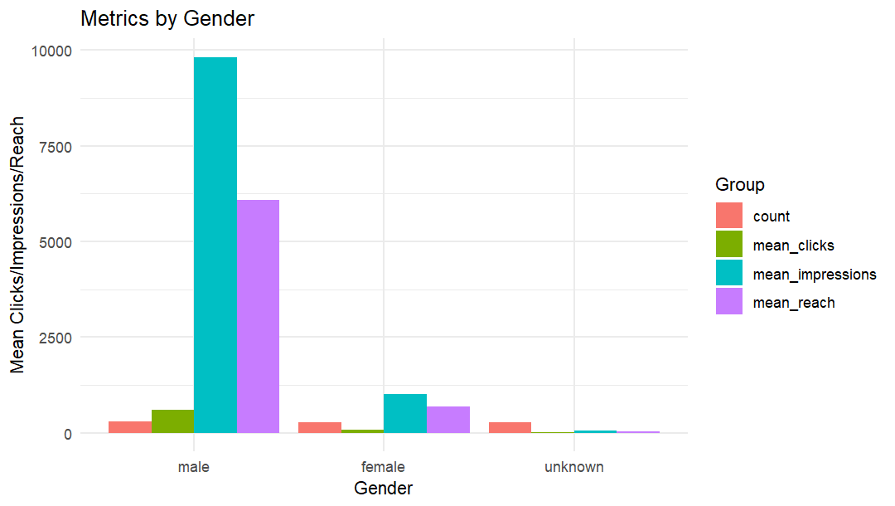

Slide 24
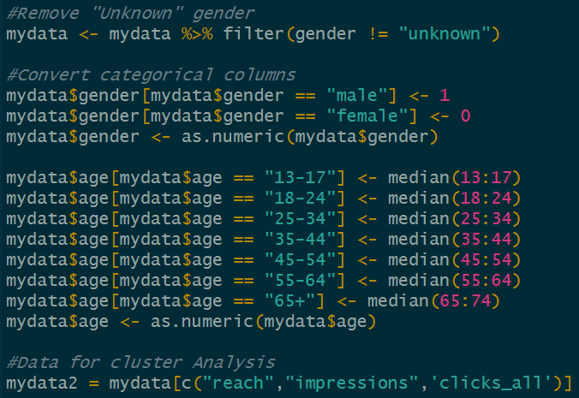
Clustering: Preprocessing
Removal of “unknown” gender and NA values set to 0.
Conversion of categorical variables into a format clustering model can interpret.
“Reach,” “Impressions” and “Clicks” are the variables of interest, hereon referred to as “Engagement.”

Slide 25
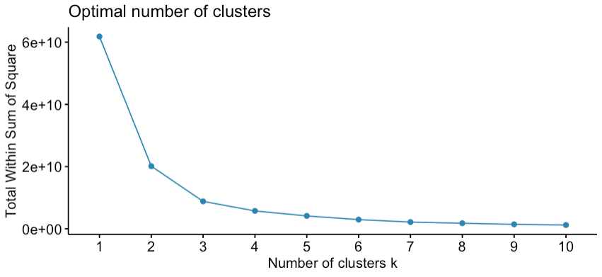
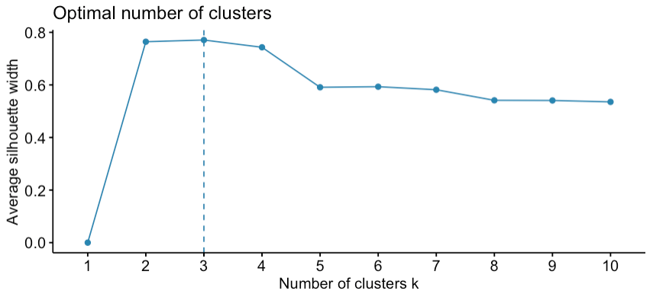
Hierarchical Cluster Analysis

Slide 26
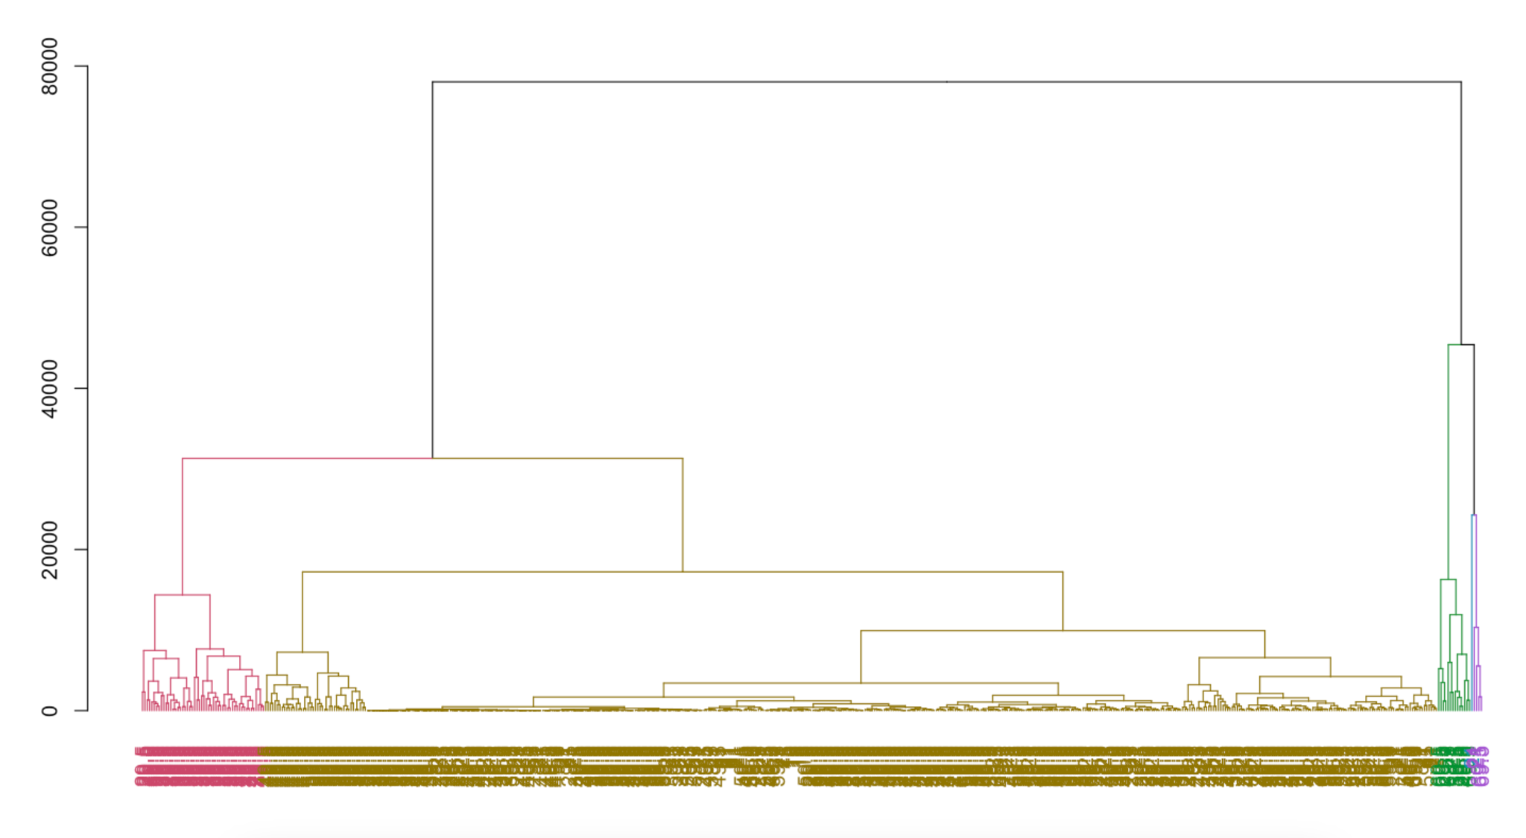
5 Clusters

Slide 27
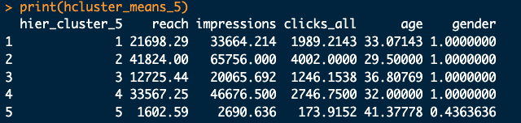
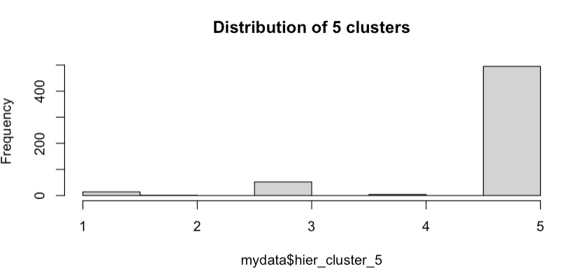
Cluster 2: 30
Cluster 4: 32
Cluster 1: 33
Cluster 3: 37
Cluster 5: 41

Slide 28
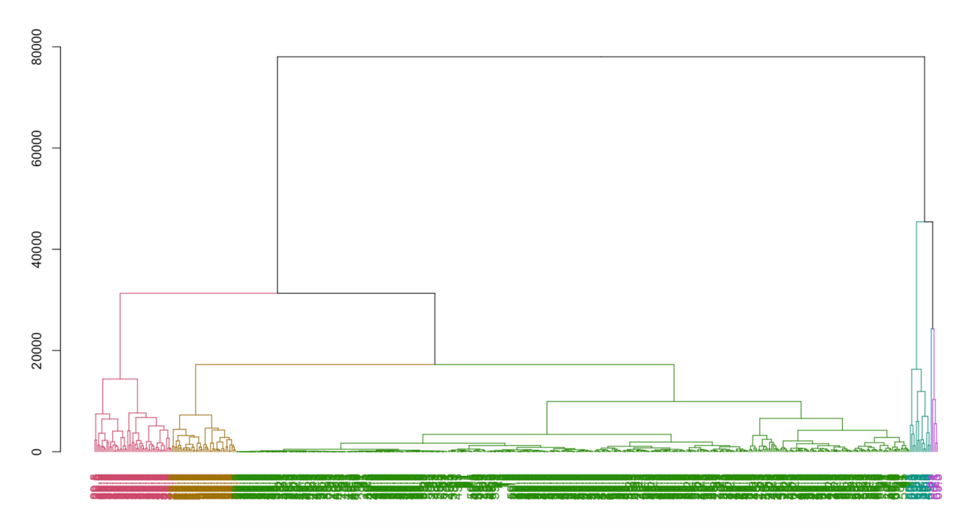
6 Clusters

Slide 29
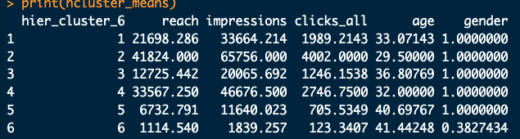
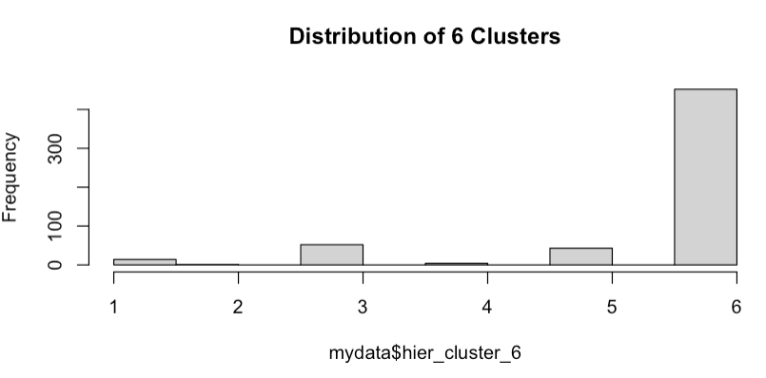
Cluster 2: 29
Cluster 4: 32
Cluster 1: 33
Cluster 3: 37
Cluster 5: 41
Cluster 6: 41

Slide 30
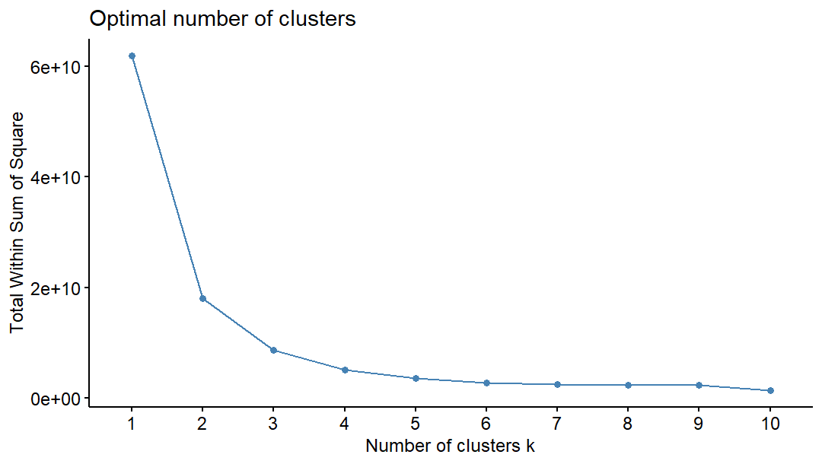
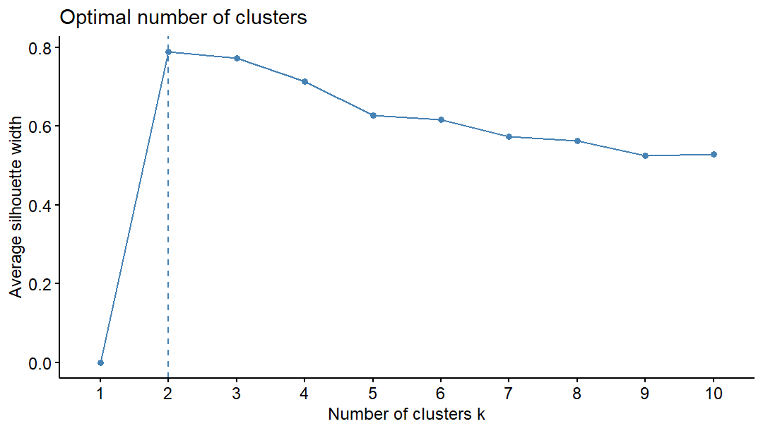
K-Means Cluster Analysis
WSS and Silhouette used to select optimal value for K (4 and 5).

Slide 31
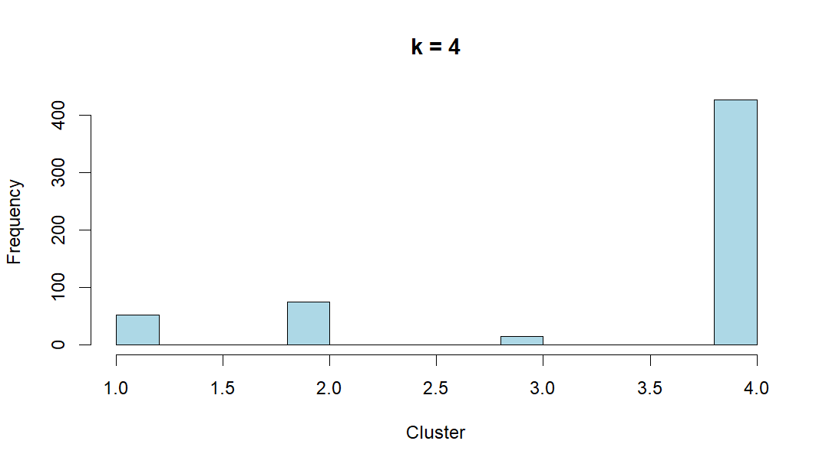

Slide 32
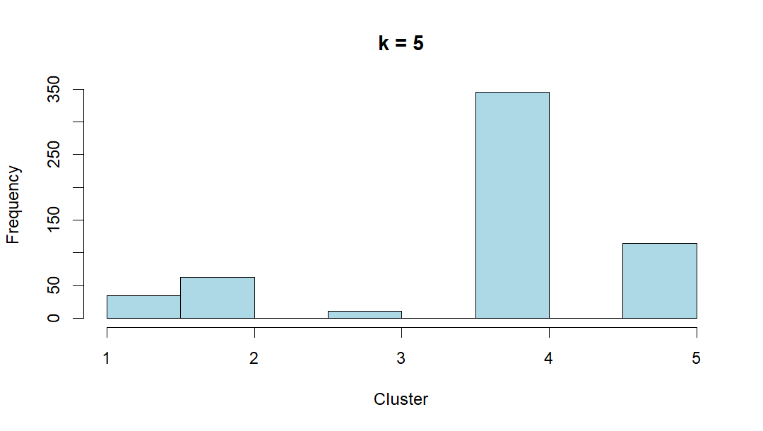

Slide 33
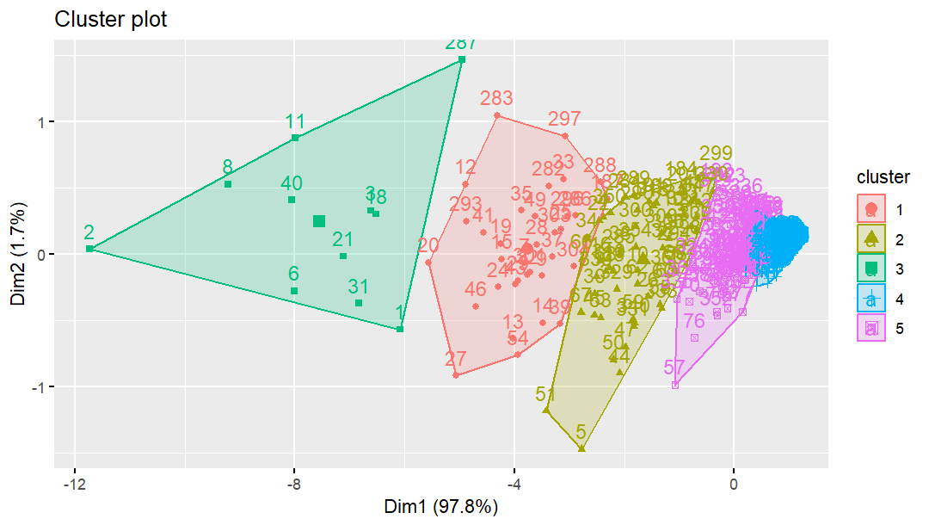

Slide 34
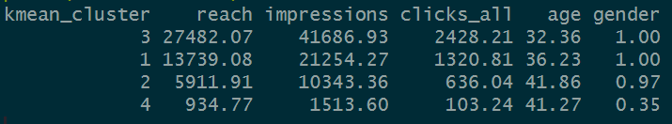
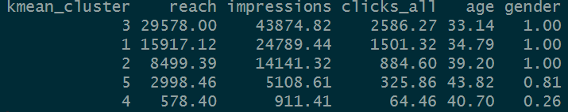
K-means: Results
K = 4
K = 5

Slide 35
Conclusions/Recommendations
Demographics for engagement are overwhelming male, usually in late twenties to early thirties.
However, female Clusters possess the highest click-through rate, at around 4% compared to Male click-through rate of ~3.5%
Much lower reach and impression on older and female clusters indicate these demographics are not seeing these ads; proportionate or higher click-through rates suggest they are not uninterested.
Sistema may want to reconsider its digital marketing approach, make ads more visible to these demographics through ads on other pages/platforms.

Slide 36
Sistema Website Pages that have more Traffic by Region using Google Analytics

Slide 37
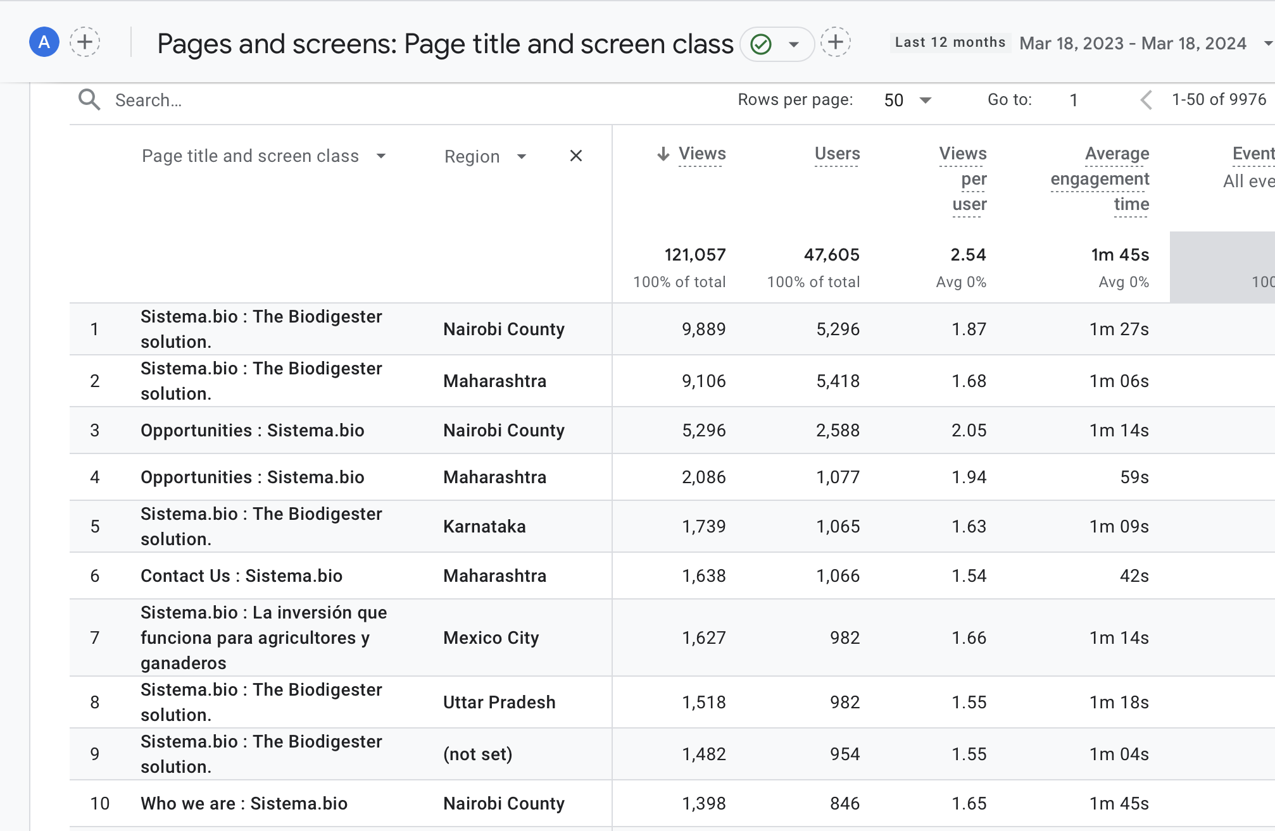
Table showing the top 10 pages by region in order from most amount of views to the least amount of views within the last 12 months:

Slide 38
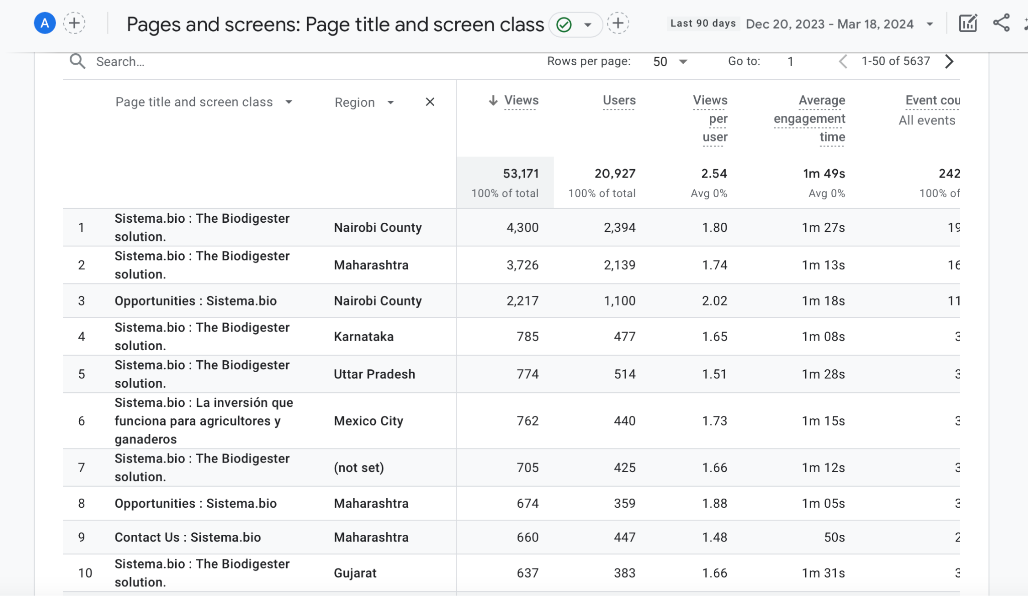
Table showing the top 10 pages by region in order from most amount of views to the least amount of views within the last 90 days:

Slide 39
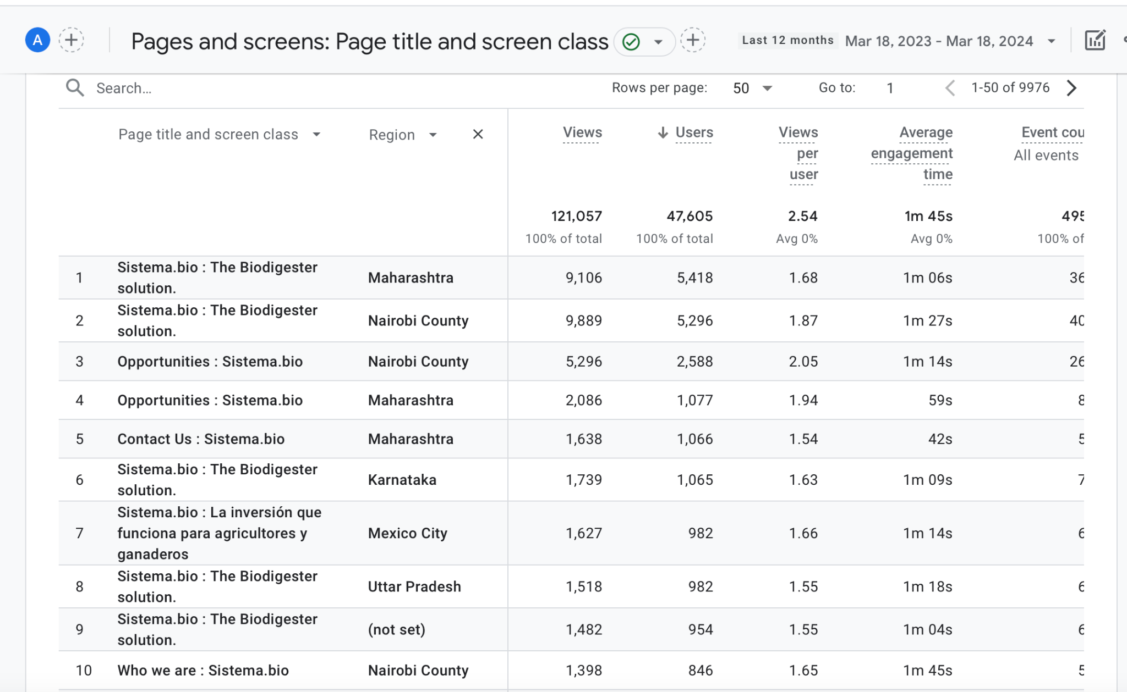
Table showing the top 10 pages by region in order from the most amount of users to the least amount of users within the last 12 months:

Slide 40
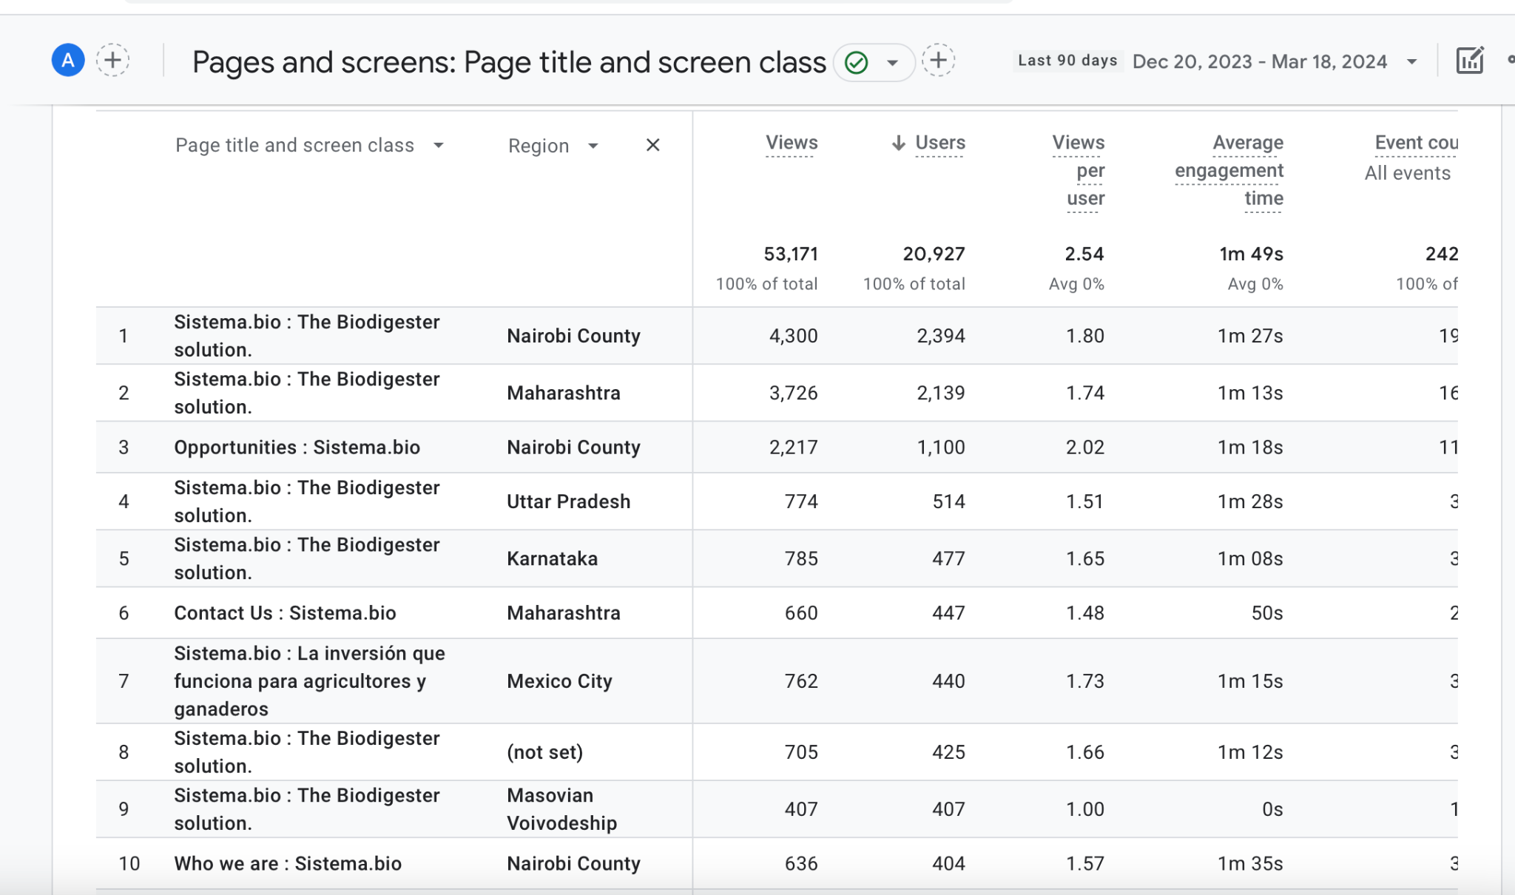
Table showing the top 10 pages by region in order from most amount of users to the least amount of users within the last 90 days:

Slide 41
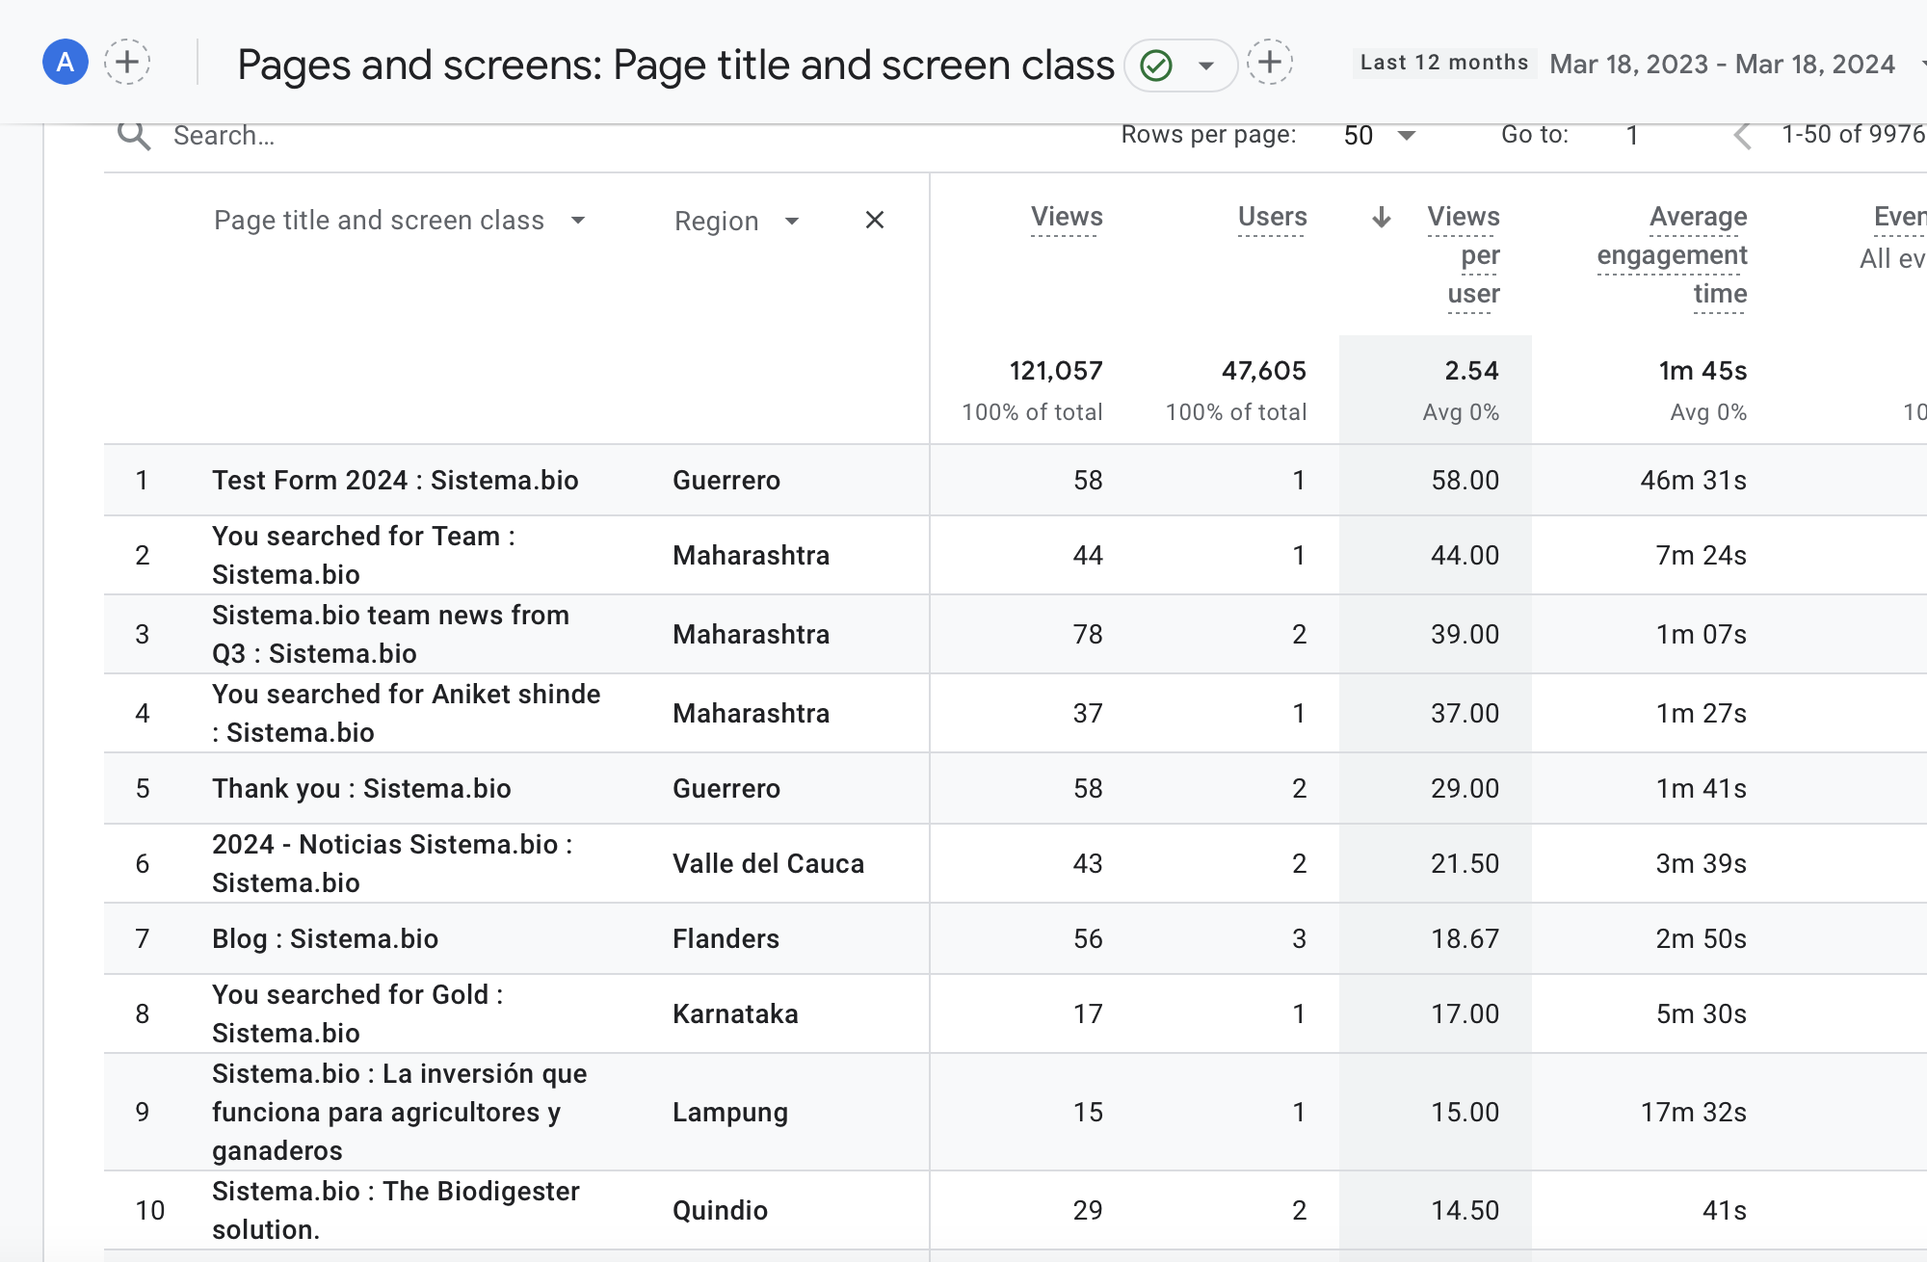
Table showing the top 10 pages by region in order from most amount of average views per user to the least amount of average views per user within the last 12 months:

Slide 42
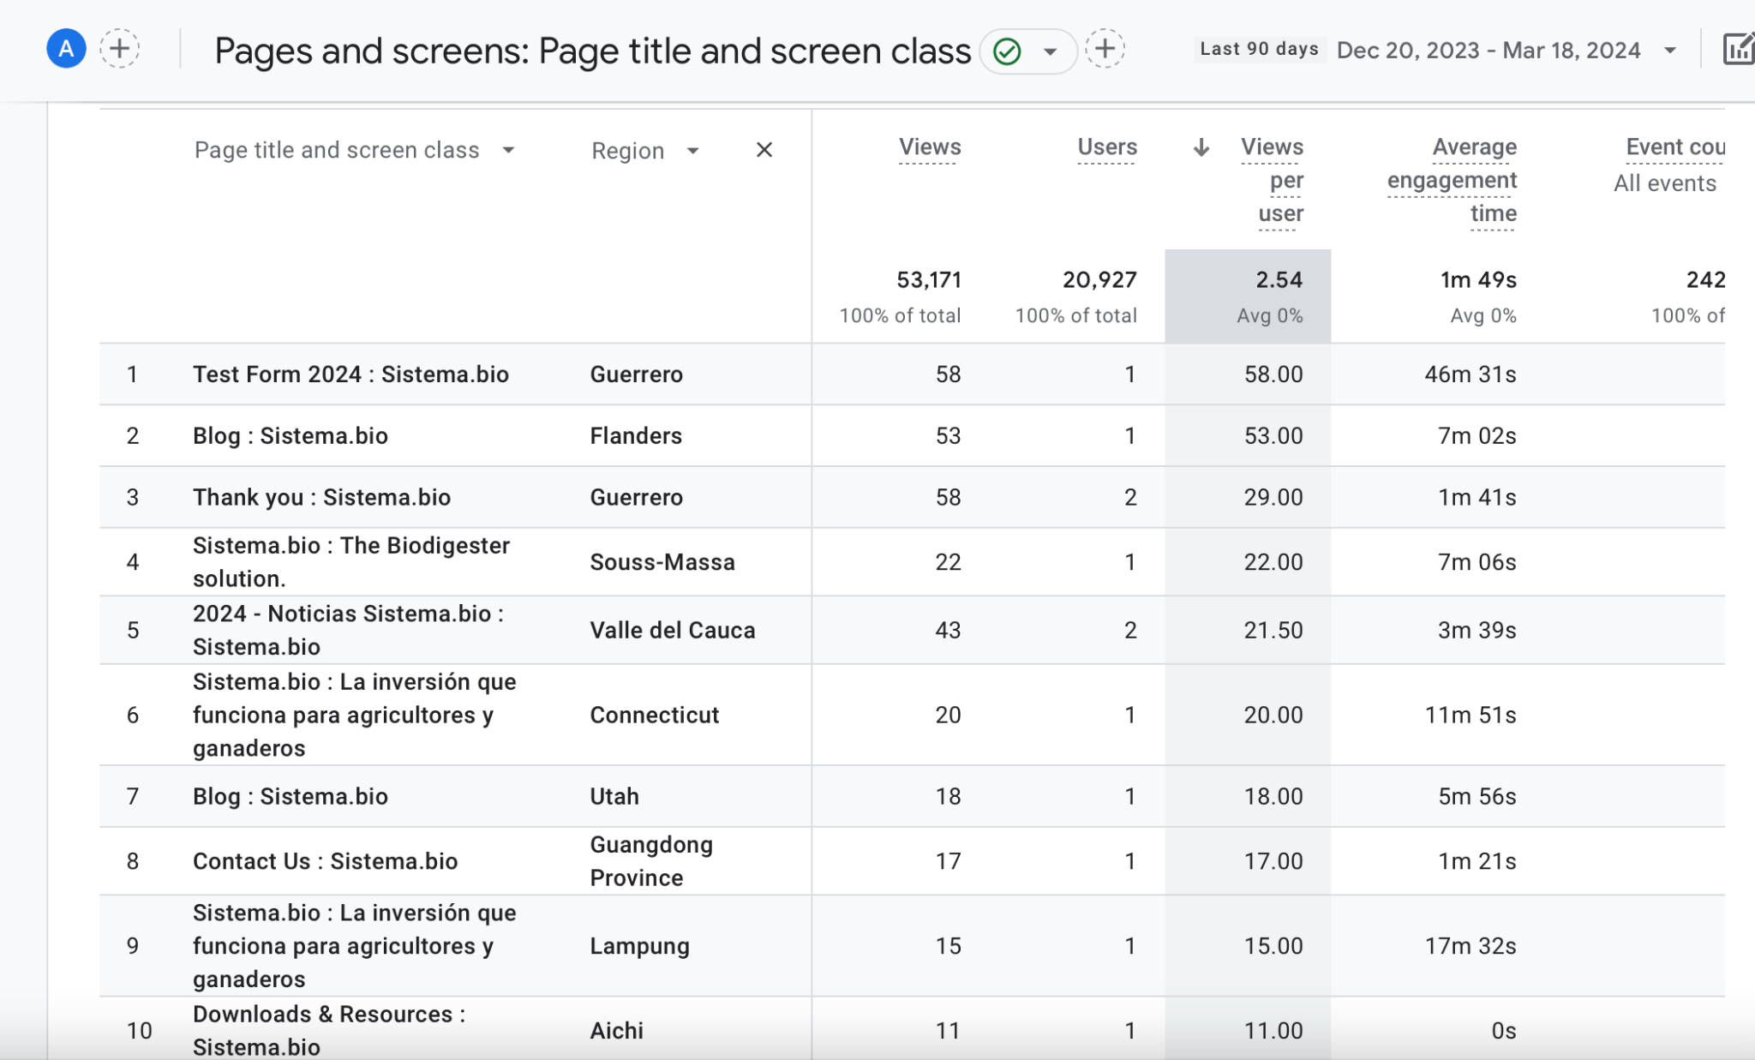
Table showing the top 10 pages by region in order from most amount of average views per user to the least amount of average views per user within the last 90 days:

Slide 43
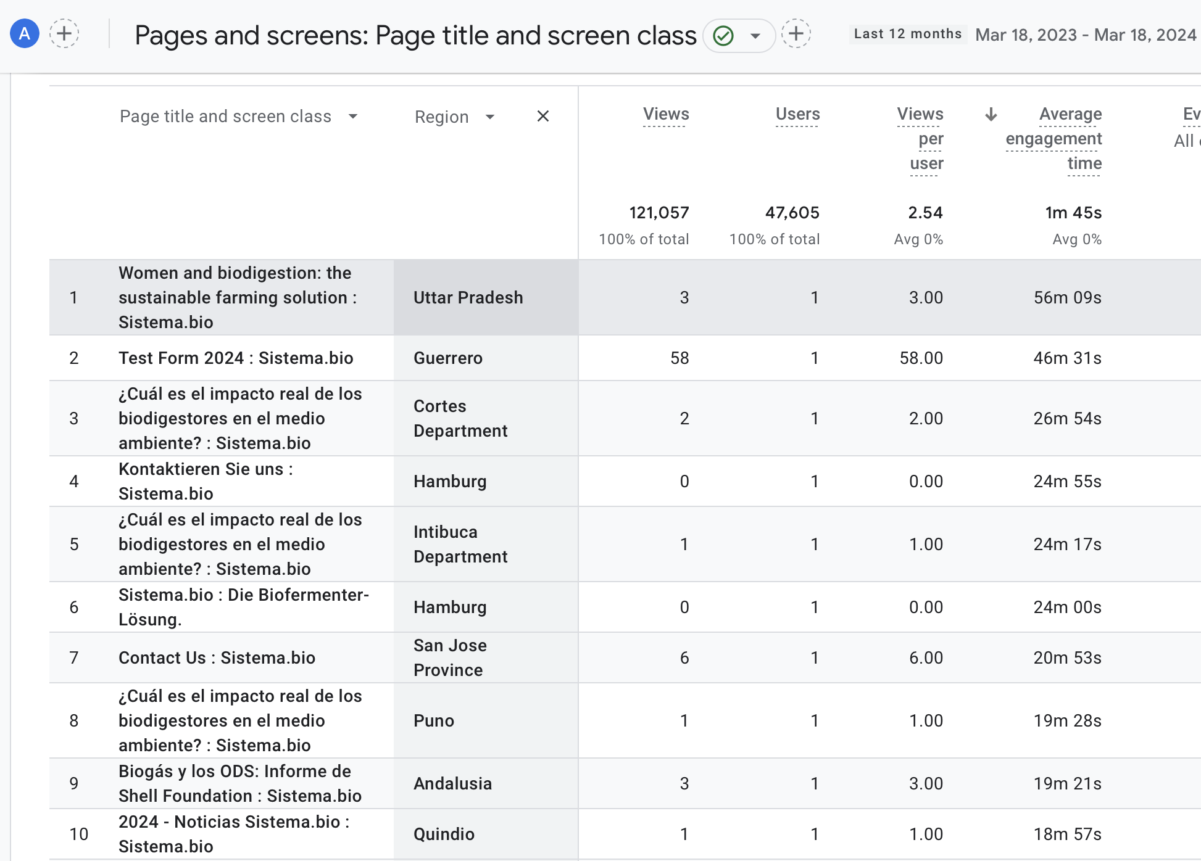
Table showing the top 10 pages by region in order from highest average engagement time to the lowest average engagement time within the last 12 months:

Slide 44
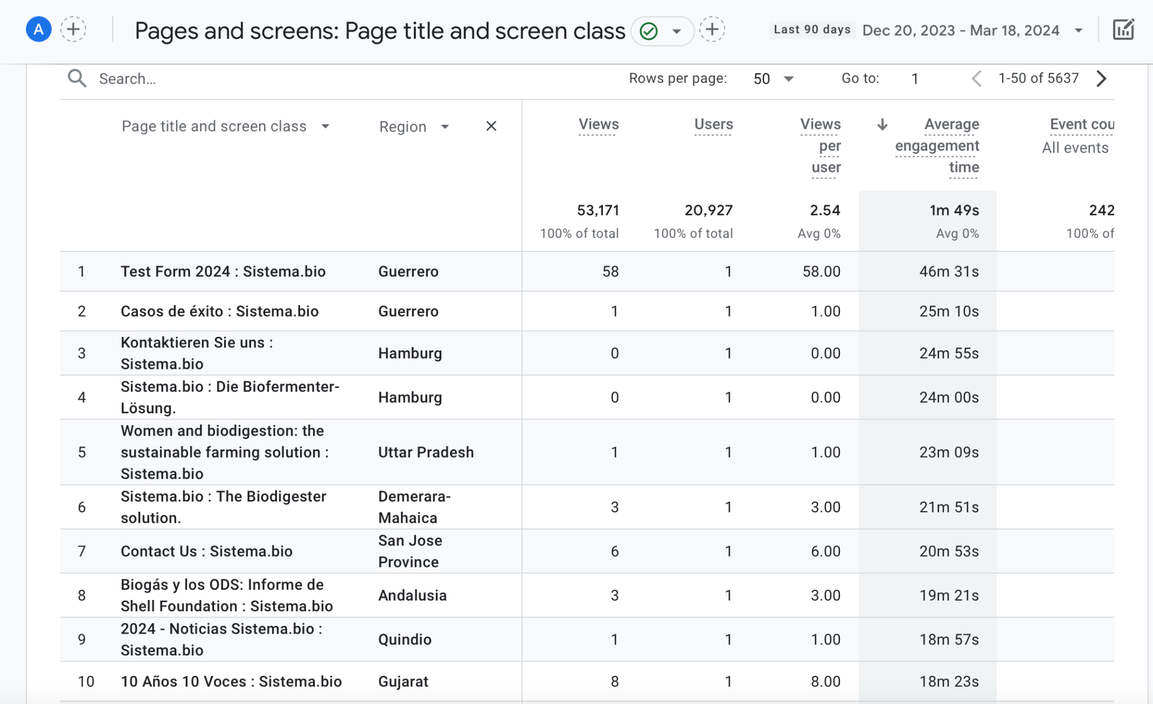
Table showing the top 10 pages by region in order from highest average engagement time to the lowest average engagement time within the last 90 days:

Slide 45
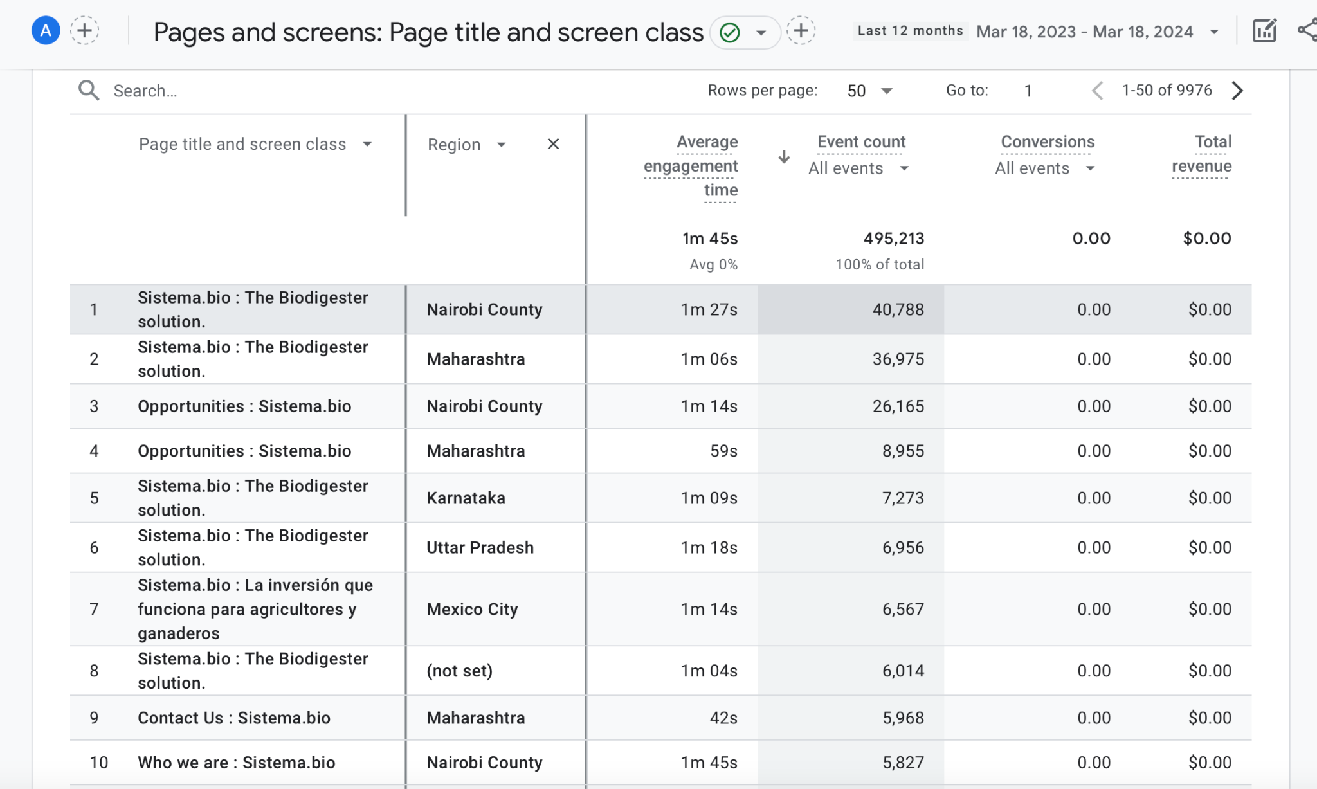
Table showing the top 10 pages by region in order from highest event count to the lowest event count within the last 12 months:

Slide 46
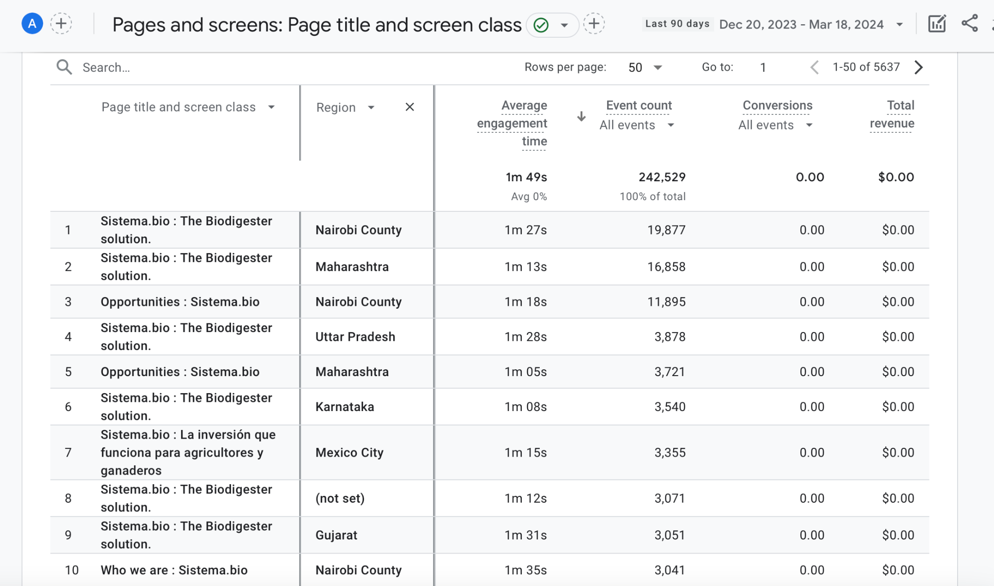
Table showing the top 10 pages by region in order from highest event count to the lowest event count within the last 90 days:

Slide 47
Conclusions/Recommendations
Certain pages, such as the Biodigester solution and Opportunities, consistently attract significant traffic across all regions.
Maharashtra and Karnataka in India, along with Mexico City in Mexico, emerge as particularly significant regions due to their consistent presence in the top-ranking pages by views and users.
These regions represent key markets, suggesting the need for targeted advertising and sponsorship efforts on popular pages.
Sistema could invest in region-specific content and marketing strategies to cater effectively to diverse audiences, potentially featuring products popular in those regions and sponsoring companies from those countries.

